Slide 1

Causes of Deaths
Submitted by
Mrs. Nupur Bhatnagar

Slide 2


Manner of Deaths
It's important to know that with every cause of death there is a manner in which a death scene investigation is conducted may be a critical factor in determining the success of an investigation.
Accidental deaths, which include a multitude of circumstances including misadventure.
Suicidal death, which include a multitude of circumstances.
Homicidal deaths, which include multitude of circumstances.
Sudden deaths, with or without suspicious circumstances.
Unknow cause of deaths, which includes, difficult victim identification.

Slide 3
Some examples of cause of death
Proximate cause of death refers to an underlying cause of death as oppose to the final cause .
Example= radiation-cancer= radiation exposure
Mechanism of death describe the specific change in the body that brought about the cessation of life.
** usually only "Cause" and "Mechanism" are listed on the death certificate**
Examples
Cause of Death:-smothering
Mechanism of death:- asphyxia
Manner of Death:- homicide
Cause of Death:- stabbing, gunshot
Mechanism of Death:- loss of blood, heart failure

Slide 4
Examples of cause of death
Heart attack, gunshot wound, skull fracture, diseases or injuries, stroke, burning, drowning, strangulation, hanging, suffocation, massive trauma, bludgeoning.
EXAMPLES OF MECHANISM OF DEATH
Exsanguination (bleeding to death)
Sepsis ( infection in blood stream)
Brain trauma (cerebral contusion)
Brain bleeding (intra-cerebral bleed)
Stop breathing (asphyxia)
Pulmonary arrest
Cardiac arrest

Slide 5

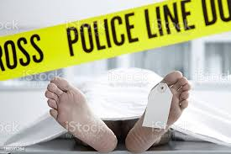
Finding cause of death at a crime scene

Slide 6
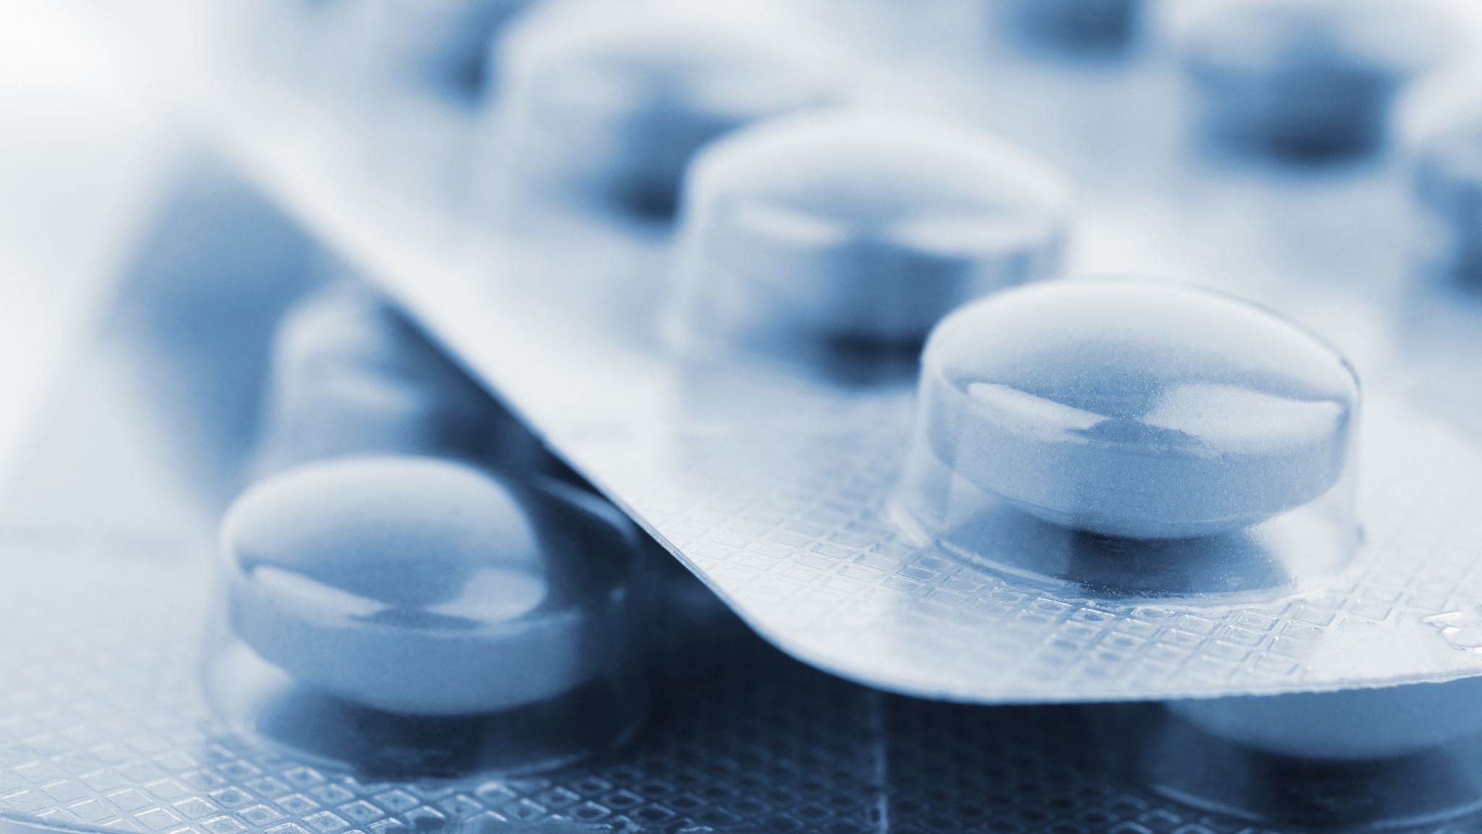
Intro
IN LOVING MEMORY
A death investigation begins with a body examination and evidence collection at a scene and proceeds through history ,physical examination, and lab tests. The objective is cause ,timing and manner of death. A complete investigation is necessary for a precise cause and manner of death.

Slide 7
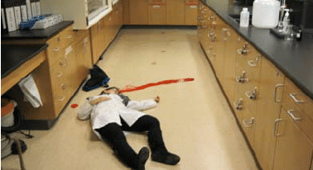
Crime and death scene
.In many cases, the scene investigation is more important than the autopsy. A thorough and complete investigation commonly leads to the proper diagnosis of the cause and manner of death prior to an autopsy. The prime crime scene is an area, place or thing, where the incident occurred or where the majority or a high concentration of a physical evidence will be found.

Slide 8
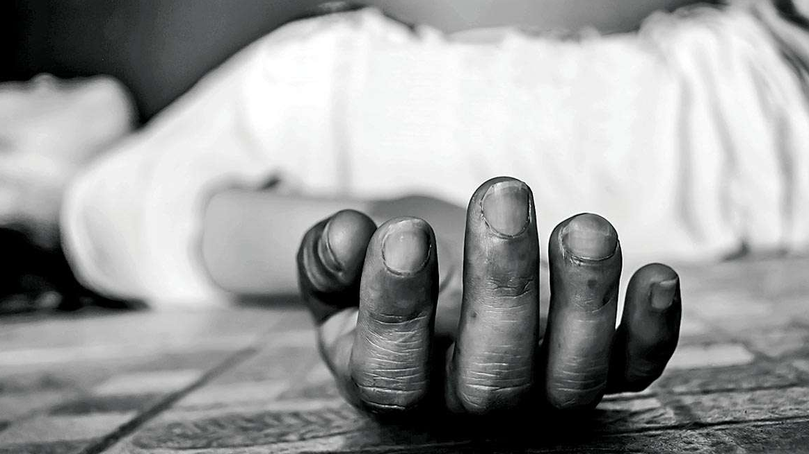
Steps of Death Scene
The deceased is the most valuable piece of evidence at any death scene. A systematic and through examination of the deceased should be taken at every death scene.
According to (Demirci & Dogan, 2011) following these steps could help serve as guide with the death scene investigation.

Slide 9
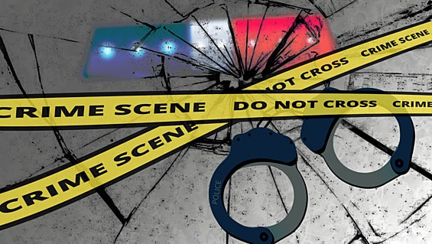
step1
Pre planning the death scene investigation. When initially notified of the deceased experts should determine as much information as possible from the caller. Was there for play or is there any instruments available that might have played a role in the subject's death .Is their trace evidence search with the death having occurred at this location? Is their external signs of evidence is there anything miss or out of the ordinary regarding the scene?

Slide 10
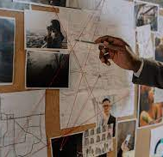
Step – 2 Cooperation among investigators
It's an opportunity to have working relationship with inner departments. As professional strive to solve the medical mystery of why that particular person died at that particular time, under a particular circumstances is crucial and extremely important for the investigation. Its best to share our knowledge, and have an open mind to others knowledge as well.

Slide 11

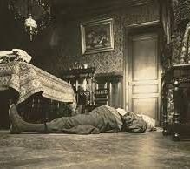
Step 3
Documentation of the Scene- All death scene should be secured and recorded by notetaking, videography, photography, and sketching. All are necessary and none are substitutes for another.

Slide 12
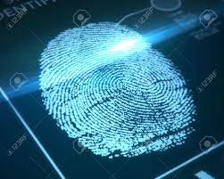
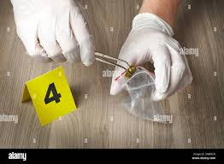
Step 4 Identification of the deceased
Positive identification of the descendent is crucial in all death inquiries. Family should be notified. It is imperative that the identification is absolutely correct, verifying medical and dental records help.

Slide 13
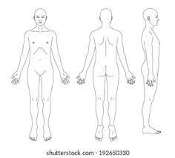
Step 5
Examination of body- A head to toe assessment of the body in prone position is necessary for documenting any anomalies. For example- fingernail marks, bruising, swelling, discoloration and abrasions . Also, remembering the environment the body was found provides insight into the nature of the case and cause of death .The assessment of the body will also determine the type of clothing, jewelry, tattoos, currency and credit cards should all be recorded as valuable items.

Slide 14
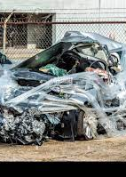
Other information scene collected
Step 6
Information that relates to cause and manner of death requires specific scene information.
For instance, a fatal motor vehicle accident vs. a small child found in a pool would require different guides to followthat relate to cause manner of death.

Slide 15
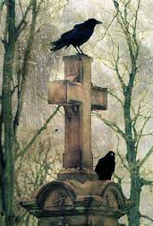
Step 7 – Determining what information has already been developed
Prior to medical examination for forensic specialists' other support personal probably have communicated with individuals and witness at the scene. Forensic experts need to know this so they can compare this information to the victim's body to determine if there are any discrepancies.

Slide 16
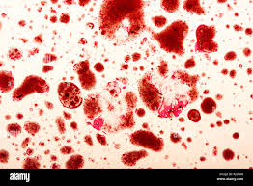
Collective evidence found at the death scene
Step 8 – Collect evidence found at the death scene.
Lead detective will walk the forensic experts through the scene, relaying information and pointing out salient features. Officers, fingerprinting, forensic lab experts taking samples, these specialized teams realize that this parameter is one giant piece of evidence that must be carefully detected within the limit of their expertise concluding as much information that can provide any evidence in the investigation. Other clues about the cause and manner of death and who committed a crime may be found at a scene. Here is a small lists of clues that might be collected. Blood, semen, fingerprints, firearms or other weapons, bullets and cartridges, hairs and fibers, suspicious food and pills, footprints and fire marks, glass, documents, cigarette, butts etc.

Slide 17
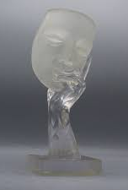
Step 9- Interviewing person regarding the death
Interviews should include that basic information such as the subject's identification, clothing, time, date, state of health, date and time body was discovered, medical history, employment and social history. Any recent or major events, accidents, trauma that may have a bearing on the death are important. In this case, it is preferable to interview family members and close friends as soon as possible after the death is discovered

Slide 18

Step 10- Estimating the post mortem interval at the scene
Temperature must be taken as soon as possible after the discovery of the body, preferably by the police scene of crime officers who usually arrive at the location before the forensic medical experts. Information should be sought as to how much disturbance of the ambient temperature might have occurred such as an open window central heating, body lying on pavement or carpet. Other unscientific methods prove to be accurate, especially true is badly decomposed bodies, the scene markers include.

Slide 19
Step 11
Ending the death scene investigation
When the forensic medical experts has made the best examination possible in the circumstances, the next function is to ensure that the corpse is removed to the mortary of autopsy. The body is screened for trace evidence such as loose objects, hair and fibers adhering to the body or clothing.

